Slide 1
Week 7 Presentation
Group 1:
Jibin Mathews Maritza Torres

Slide 2
Objective
Make a course for the Lab 1 Group that is heavy on sensing and signaling.
Rover must complete the course in 60 seconds
Track Position of Rover and Determine speed required to finish on time
Course communication for various actions
IR and Sound

Slide 3
Deliverables
Template Matching
Tracking Dots
Track Multiple Dots

Slide 4
Track Elements
Utilize Metallic Strip as path for rover to follow
Use IR Sensor and Sound Communication to Decode/ Encode Information with Rover
Track Rovers location

Slide 5
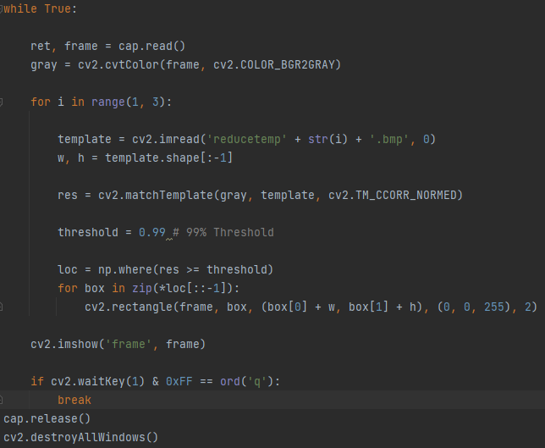
Template Matching with Threshold

Slide 6
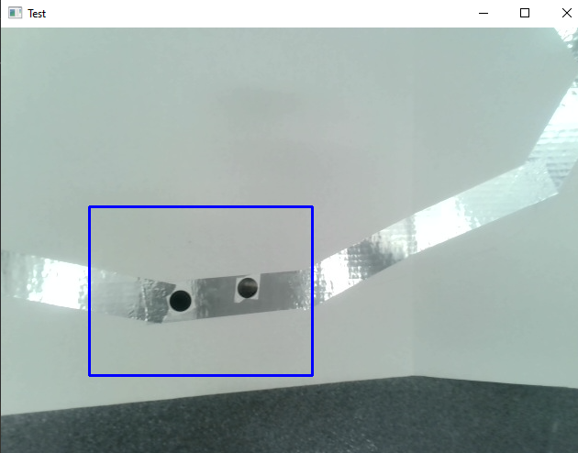
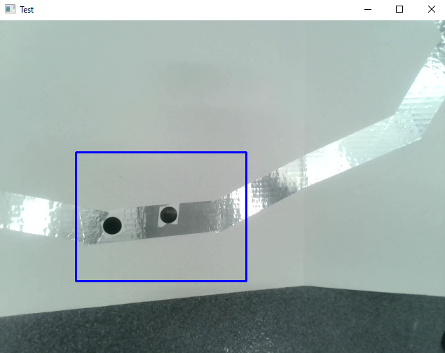
Output

Slide 7
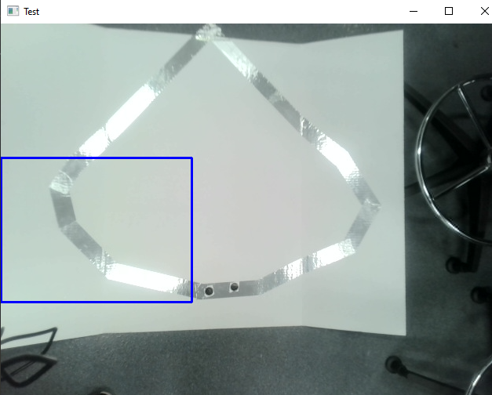
Issue

Slide 8
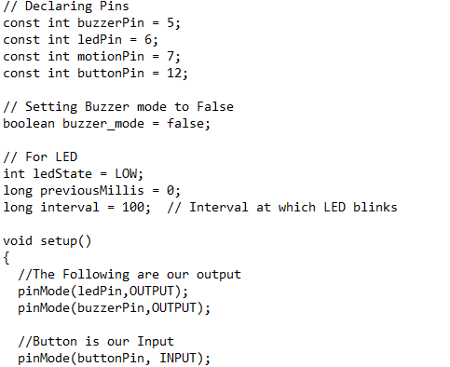
Buzzer Snippet of Code
// Declaring Pins
const int buzzerPin = 5;
const int ledPin = 6;
const int motionPin = 7;
const int buttonPin = 12;
// Setting Buzzer mode to False
boolean buzzer_mode = false;
// For LED
int ledState = LOW;
long previousMillis = 0;
long interval = 100; // Interval at which LED blinks
void setup()
{
//The Following are our output
pinMode(ledPin,OUTPUT);
pinMode(buzzerPin,OUTPUT);
//Button is our Input
pinMode(buttonPin, INPUT);
// Wait before starting the alarm
delay(5000);
}
void loop()
{
// To chech whether the motion is detected or not
if (digitalRead(motionPin)) {
buzzer_mode = true;
}
// If alarm mode is on,blink our LED
if (buzzer_mode){
unsigned long currentMillis = millis();
if(currentMillis - previousMillis > interval) {
previousMillis = currentMillis;
if (ledState == LOW)
ledState = HIGH;
else
ledState = LOW;
// Switch the LED
digitalWrite(ledPin, ledState);
}
tone(buzzerPin,1000);
}
// If alarm is off
if (buzzer_mode == false) {
// No tone & LED off
noTone(buzzerPin);
digitalWrite(ledPin, LOW);
}
// If our button is pressed Switch off ringing and Setup
int button_state = digitalRead(buttonPin);
if (button_state) {buzzer_mode = false;}
}

Slide 9
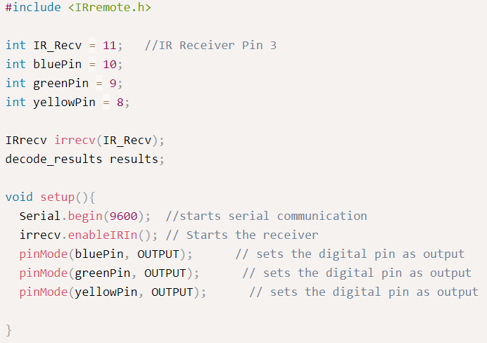
Snippet of Code for IR Sensor using Arduino IDE

Slide 10
Budget
Budget Lab 2 Project | Cost: | Total Spent:
Raspberry Pi 4 Model B | $129.99 | $0.00 |  | Material Costs | Cost: | Total Spent:
IR Receiver Module | $7.40 | $7.40 |  |  | $250.84 | $120.85
Misc. (LED, Resistors, Jumper wires) | $10.00 | $10.00
Onn. Webcam | $27.00 | $27.00 |  | Totals | Total Cost: | Actual Cost:
Elegoo Uno R3 (arduino) | $16.99 | $16.99 |  |  | $250.84 | $120.85
Buzzer | $1.04 | $1.04
USB Type B - A cable connector | $29.99 | $29.99
Breadboards | $9.99 | $9.99
2N9304 Transistor | $0.44 | $0.44
Track Elements
Whiteboard | $13 | $13.00
Metallic Tape | $5.00 | $5.00

Slide 11
Gantt Chart
Lab 2 | Week 1 | Week 2 | Week 3 | Week 4 | Week 5 | Week 6 | Week 7
Hardware
Research
Path
Sensors
IR Receiver/ Transmitter
Buzzer
Object Tracking w/ Camera
Software
Research
Download/ Install: Python/ OpenCV
Actual Coding
Track

Slide 12
Next Week's Deliverables
Implement Dots onto Track
Progress on Algorithm for Rover Tracking

Slide 13
References
OpenCV: Real time road lane detection. GeeksforGeeks. (2022, January 18). Retrieved June 28, 2022, from https://www.geeksforgeeks.org/opencv-real-time-road-lane-detection/
chrome-extension://efaidnbmnnnibpcajpcglclefindmkaj/https://www.aatc.tw/images/pdf/20200508291bd.pdf
https://www.aatc.tw/products.php?lang=en&id=635
Nayar, S. K. (2021, March 1). Template matching by Correlation | Image processing I. YouTube. Retrieved July 12, 2022, from https://www.youtube.com/watch?v=1_hwFc8PXVE&ab_channel=FirstPrinciplesofComputerVision
Tomasi, C., & Manduchi, R. (n.d.). Bilateral filtering for gray and color images. IEEE Xplore. Retrieved July 12, 2022, from https://ieeexplore.ieee.org/document/710815
Wilhelm, M., Nutter, B., Long, R., & Antani, S. (n.d.). Linear Array image analysis for automated detection of human papillomavirus. IEEE Xplore. Retrieved July 12, 2022, from https://ieeexplore.ieee.org/abstract/document/5255266
https://wiki.dfrobot.com/DIGITAL_IR_Transmitter_Module__SKU_DFR0095_

Slide 14
Questions
?

